Slide 1

INTRODUCING THE ANTI-COUNTERFEITING FORUM
Roger Rogowski
Anti-Counterfeiting Forum
March 2018

Slide 2
ABOUT THE FORUM
Was a subsidiary of ESCO, an industry body comprising the leading trade associations representing the electrotechnical UK industry. The Forum is now an independent organisation under the management of Elan Business Support Ltd
The Forum helps to exchange, develop and disseminate best practice and intelligence to mitigate against the threat of counterfeits in the electronic and electrical supply chains by:
Working closely with a number of Government and industry bodies and attending a number of relevant Government / industry forums
Managing the Anti-Counterfeiting Forum website, organising annual counterfeit awareness seminars and providing presentations and talks at relevant industry events.
Note: the website is funded entirely by sponsorship to enable all content to be accessible free of charge

Slide 3
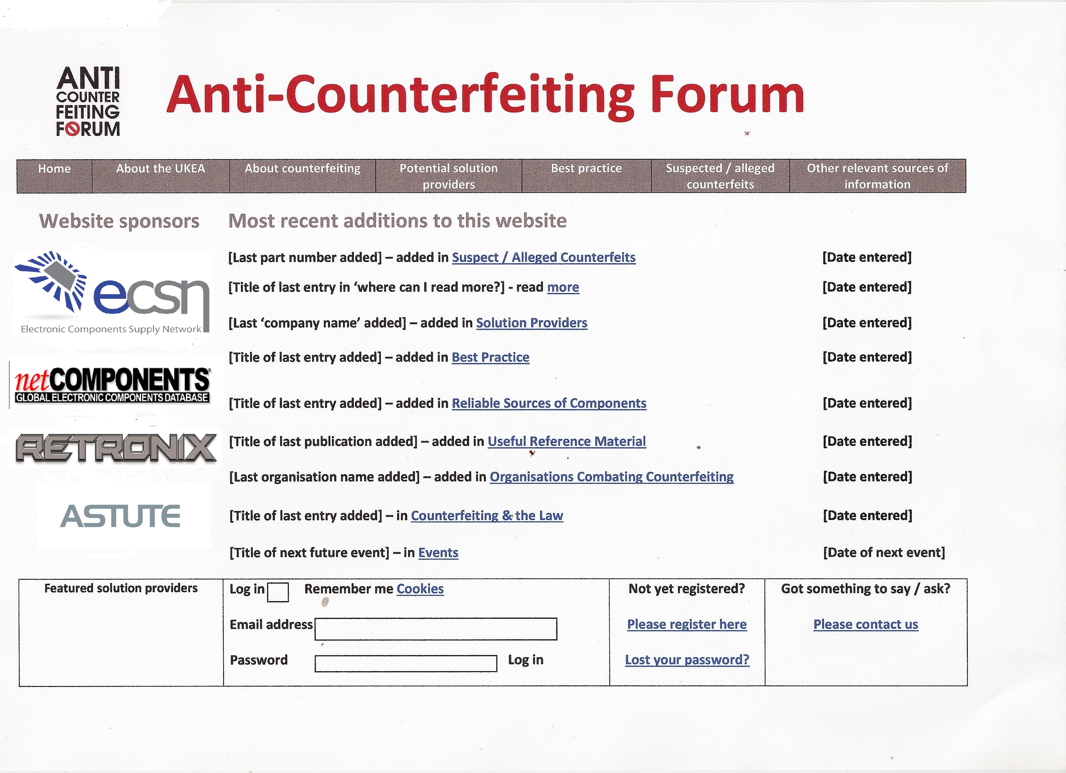
Website overview
Website content already in the public domain is available to view by visitors
Content unique to the website is available to view subject to free of charge registration – our website user community

Slide 4
THE WEBSITE USER COMMUNITY CONTINUES TO GROW
Other countries include:
Australia Belarus Belgium Brazil
Canada China Czech Republic
Denmark Egypt Finland France
Germany India Ireland India Ireland
Israel Italy Japan Malaysia
Netherlands New Zealand Norway
Poland Russia Serbia Singapore
Slovenia Spain Sweden Switzerland
Thailand

Slide 5
The website contains links to a wide variety of relevant online information in the public domain
Best practice including international standards and other guidance documents
Counterfeiting and the law relevant legislation from the EU, UK and USA
Events relevant conferences, seminars, workshops and other events open to the business community around the world
News from around the world on significant events relating to counterfeiting
Organisations combating counterfeiting industry bodies other thn solution providers engaged in anti-counterfeiting activities in the electrotechnical and other supply chains
Solution providers commercial organisations such as after market manufacturers, audit and certification services, manufacturers and suppliers of test equipment, suppliers of overt and covert security marking and tags and test houses
Useful reference material including distance learning, guides, papers, presentations, reports, videos, webinars

Slide 6
REGISTERED USER ONLY ACCESSIBLE CONTENT
Register free of charge!!
Counterfeit component database ability to search by part number and wildcard and upload/report new cases
Online document library original material not published elsewhere including articles, presentations, reports and studies
Registered users receive customisable email alerts when new content is added to the website

Slide 7




finally
For further information, please visit our website
https://www.anticounterfeitingforum.com
And/or contact us at
https://www.anticounterfeitingforum.com/contact.aspx

